Slide 1



MetroPlan Orlando Transportation System Management & Operations Committee
December 1, 2023

Slide 2

What is Advanced Air Mobility (AAM)?
Image credit: NASA
Electric Vertical Takeoff and Landing (eVTOL) vehicles
Passengers and cargo at low altitudes
Potential to fly +/-150 miles on a single charge
150-200 mph
Mature AAM network will consist of vertiports located on rooftops or garages in urban settings, hospitals, airports, and other major multimodal transportation hubs throughout the CFL region.
Notes:
https://www.faa.gov/uas/advanced_operations/urban_air_mobility/

Slide 3

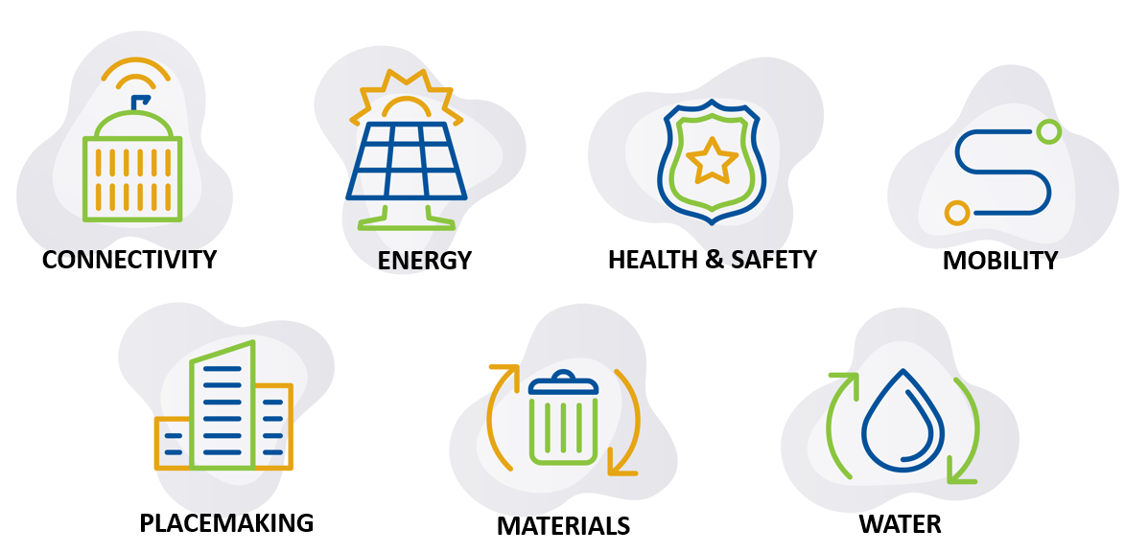
Mobility Strategy: Develop a plan to engage private sector eVTOL takeoff and landing companies to connect activity centers within the Central Florida region (city taxi model) and connect Orlando to other cities within the southeast.
Notes:
Mike

Slide 4
Why is it important for the City?
Cities and counties must be at the forefront of the conversation on AAM and be active participants in policy formulation
No one knows the City better than ourselves, and no one is better positioned to understand the potential impacts of AAM
Enhanced mobility and transportation alternatives
Continued innovation with our regional partners
Equity considerations
AAM/UAM is regional in nature and must be considered with regional partners

Slide 5

Phase One
  Technical Memorandums on Regional Transportation and Environmental Challenges and Opportunities
  Economic Impact Study of Geico Garage
  NASA Community Planning Annex
  Stakeholder outreach and regional visioning
Phase Two
  Zoning and regulations review
  Agency coordination
Phase Three
  Travel Demand Model
  Vertiport target locations
  Additional stakeholder outreach
Notes:
VHB

Slide 6
Economic
There will be positive economic benefits (employment, taxes, GDP), but it is too early for the City to invest in infrastructure without a partner
The potential costs ($30M capital cost, $0.6-$1M/year parking revenue loss,) outweigh the direct fiscal impacts back to the City ($4.3M tax revenue over a 20 year period, as estimated by IMPLAN).
To move forward, the City should negotiate an agreement with an AAM operator, detailing
  Cost-sharing responsibilities
  Revenue sharing (if applicable)
  Performance measures
  Ground lease payments back to the City.
The Agreement will help the City understand the return on investment (ROI) before making capital investments.

Slide 7
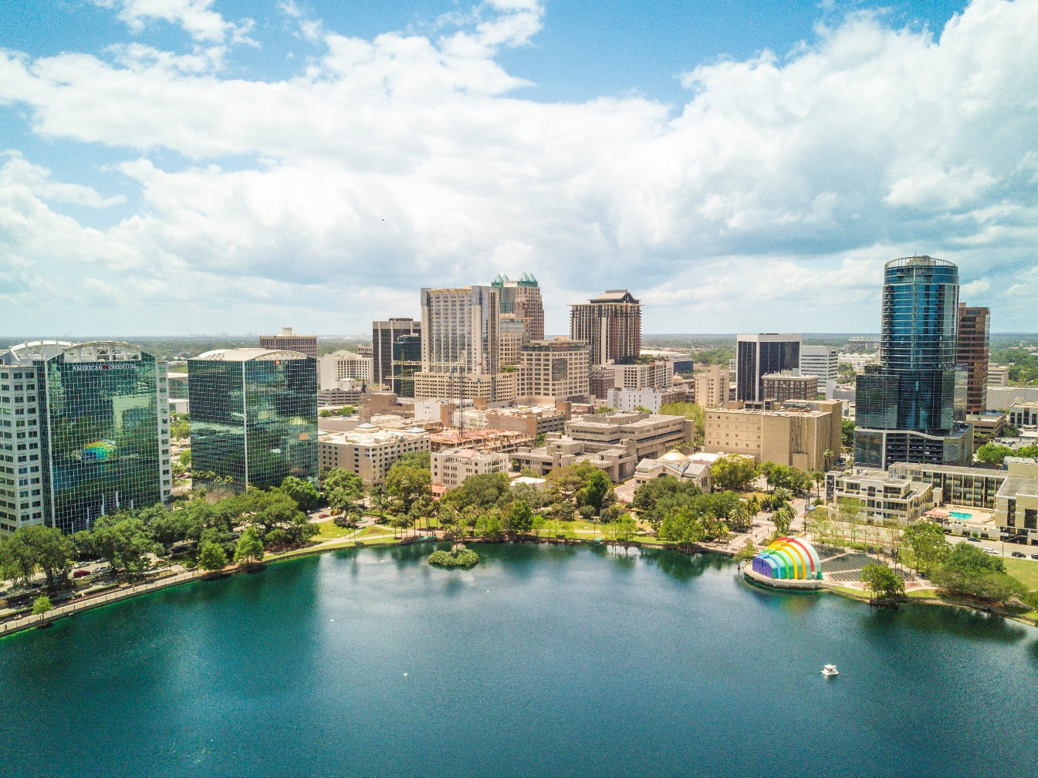
Phase One
  Technical Memorandums on Regional Transportation and Environmental Challenges and Opportunities
  Economic Impact Study of Geico Garage
  NASA Community Planning Annex
  Stakeholder outreach and regional visioning
Phase Two
  Zoning and regulations review
  Agency coordination
Phase Three
  Travel Demand Model
  Vertiport target locations
  Additional stakeholder outreach
Notes:
VHB

Slide 8
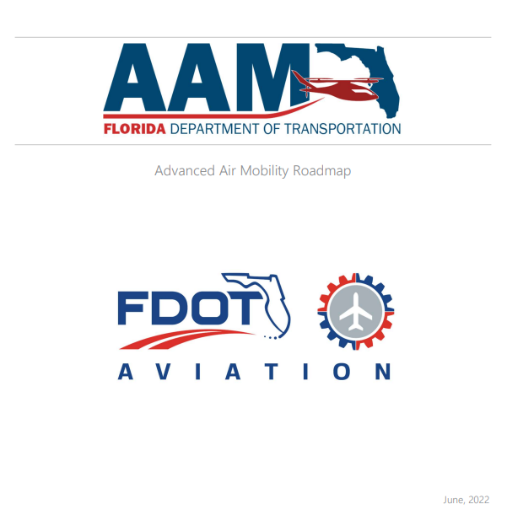
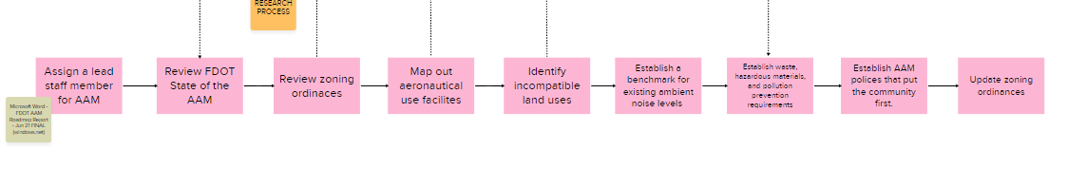
FDOT Recommended Best Practices
Assign a lead staff member for AAM
Review FDOT State of AAM
Review zoning ordinances
Map out aeronautical use facilities
Identify incompatible land uses
Establish a benchmark for existing ambient noise levels
Establish waste, hazardous materials, and pollution prevention requirements
Establish AAM Policies that put the community first
Update Zoning ordinances

Slide 9
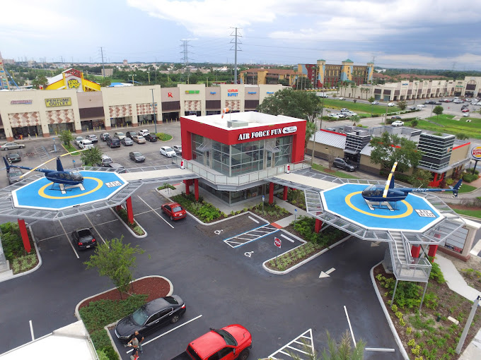
City of Orlando Vertiport Approval Process
Chapter 58, Part 4P Vertiports City of Orlando Land Development Code
Zoning Districts
Conditional Use Permit
Image from: Air Force Fun Helicopter Tours North

Slide 10
1. Chapter 58, Part 4P Vertiport Standards
Sec 58.850 – 58.853 of the Land Development Code regulates Vertiport permitting in the City of Orlando (Ordinance 9-16-1991)
The classifications of vertiports defined in Chapter 8 of this City Code as Class I, II and III and the subclassifications thereof as Subclass A, B and C shall be deemed to be the same respective classifications and subclassifications as are contained in the Federal Aviation Administration (FAA) booklet entitled "Heliport Design Guide," AC 150/53901A, dated November 5, 1969. All recommendations set forth therein relating to the location, design, construction, visual markings, and fire protection for such vertiports shall be the requirements of this Chapter; provided, however, that a Variance therefrom may be granted in accordance with Chapter 65, Part 2J if the Federal Aviation Administration advises the City that such variance will not render such vertiports unsafe.

Slide 11
2. Applicable Zoning Districts
Table FG-2B: Table of Allowable uses lists Vertiports as a Conditional Use in the following Zoning Districts:
  AC-1: Community Activity Center
  AC-2: Urban Activity Center
  AC-3: Metropolitan Activity Center
  I-G: Industrial General
  I-P: Industrial Park
Rezoning application (and Growth Management Plan amendment, if necessary) required for all other zoning districts

Slide 12

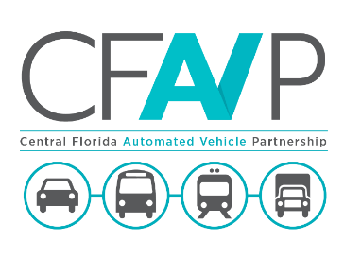

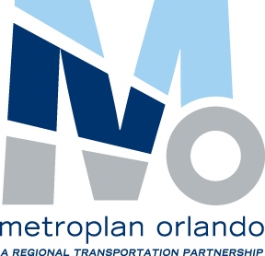









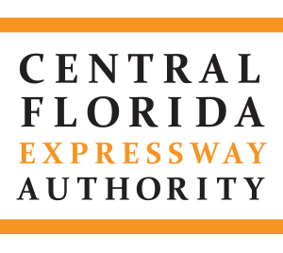




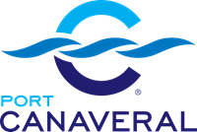

Stakeholder Engagement
Notes:
Tanya

Slide 13

Key Questions
How do we project possible demand and preferred vertiport location
Who owns and operates vertiports
How do we ensure safe operations and integrations into existing airspace and ground transportation networks
What happens when we move out of the regulatory phase, what community partners do we need to engage
How do we regulate, measure and enforce external impacts (noise, visual pollution…)
How does approval of a Vertiport affect property rights
What type of information/data sharing will be required

Slide 14
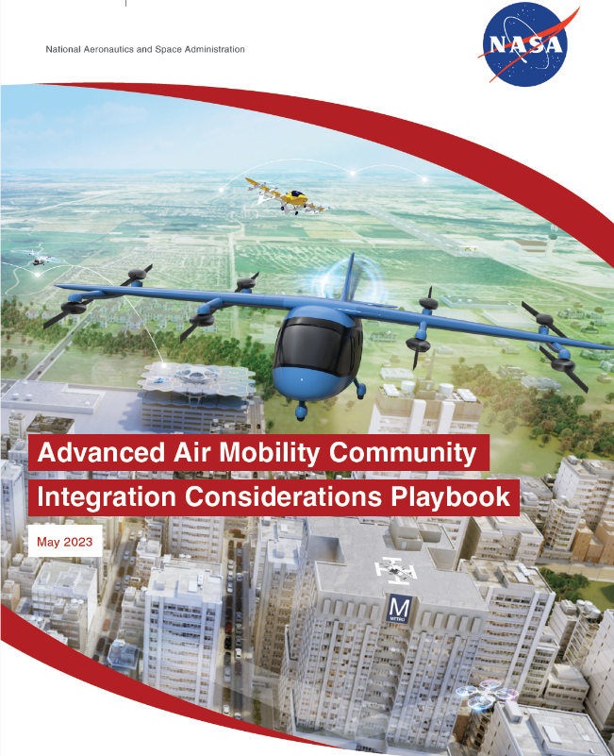
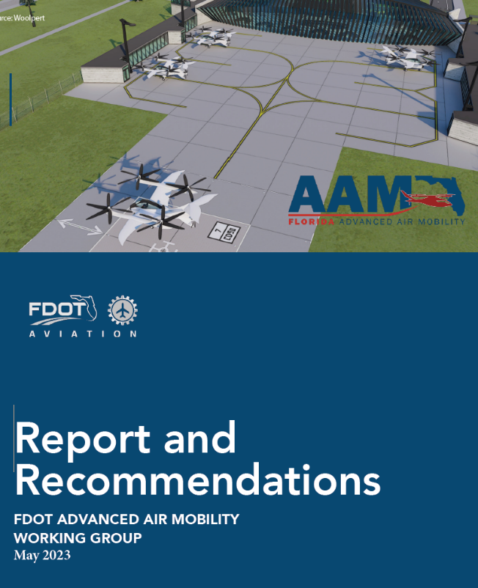
Resources
NASA – Community Integration Considerations Playbook
FDOT – AAM Working Group – Policy Report and Recommendations
American Planning Association – Planning for AAM Guidebook
NAS Transportation Research Board (TRB) - New Users of Shared Airspace
Conferences – APA National Conference, NASAO National Conference, International Civil Aviation Organization, Berkley Future of Aviation, Smart Cities Connect

Slide 15

Thank You!
orlando.gov/futureready
Notes:
Charles to close

