Slide 1
Safety Moment
School Bus Safety
August 2026

Slide 2


Safety Moment
School Bus Safety
2016
16-year-old Fort Myers High School student Cameron Mayhew struck and killed by driver who illegally passed stopped school bus while stop arm was extended
Notes:
The state’s decision to pursue only a traffic citation reflected the legal handling of such incidents in Florida, where certain traffic‑related fatalities may not result in criminal charges if the driver’s actions are deemed to fall under traffic law violations rather than criminal negligence or intent.

Slide 3
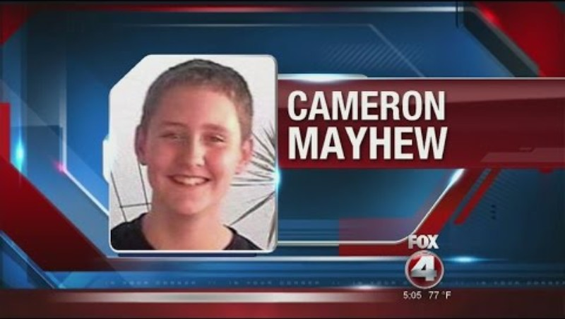

Slide 4

Safety Moment
School Bus Safety
23-year-old driver pled not guilty
Penalties imposed:
A six-month driver’s license suspension
A $1,000 fine
Completion of a driver improvement

Slide 5
What changed after this tragedy?
Cameron Mayhew Act
2017
The Cameron Mayhew Act took effect in Florida
Increases minimum penalty for drivers who illegally pass a stopped school bus, resulting in injury or death of another person
Penalties include:
  120 community service hours in trauma center or hospital
  Participation in victim’s impact panel session or FLHSMV approved driver improvement course
  Six points on driver's license
  Suspension of license for a minimum of one year
  $1,500 fine
Notes:
The legislation was requested by Michael Mayhew and Sherry Stevens, the parents of Cameron Mayhew
The offender required to attend a VIP as part of your sentencing or probation conditions can check with the probation officer or the court for the nearest panel schedule. Some programs, like You Impact Victim Impact Panel - Home | YouImpact, offer online alternatives that include real-life victim stories and reflection exercises

Slide 6

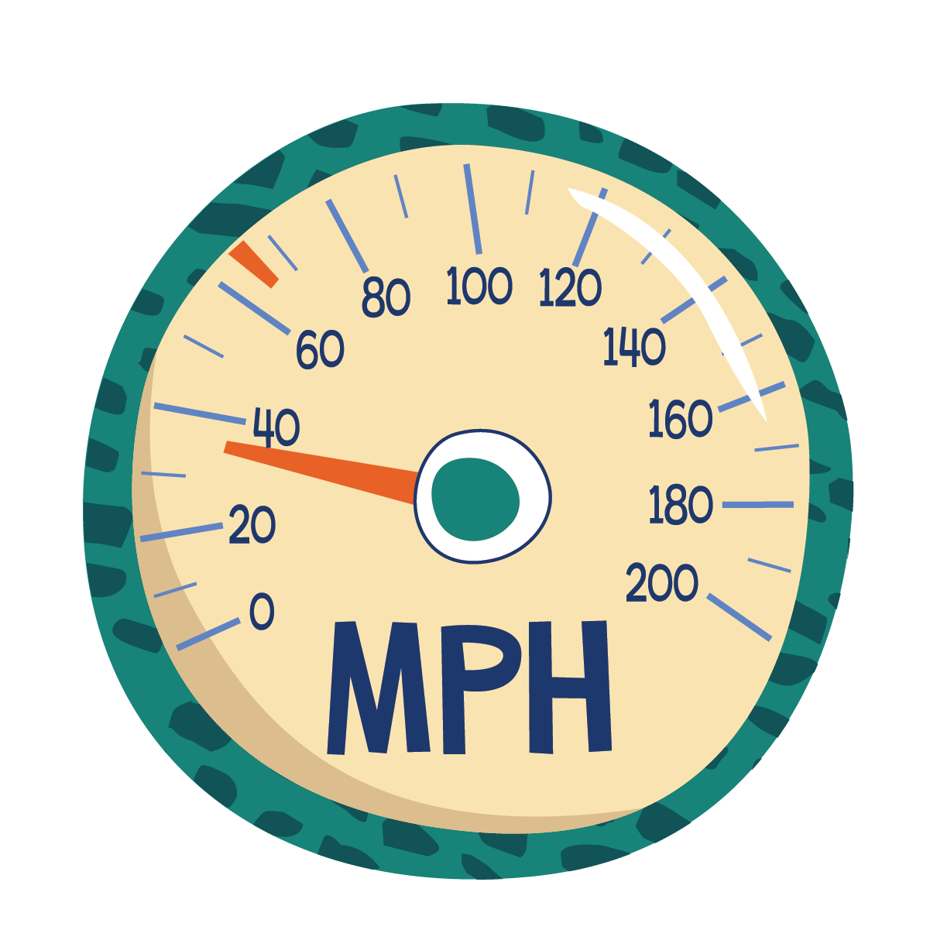
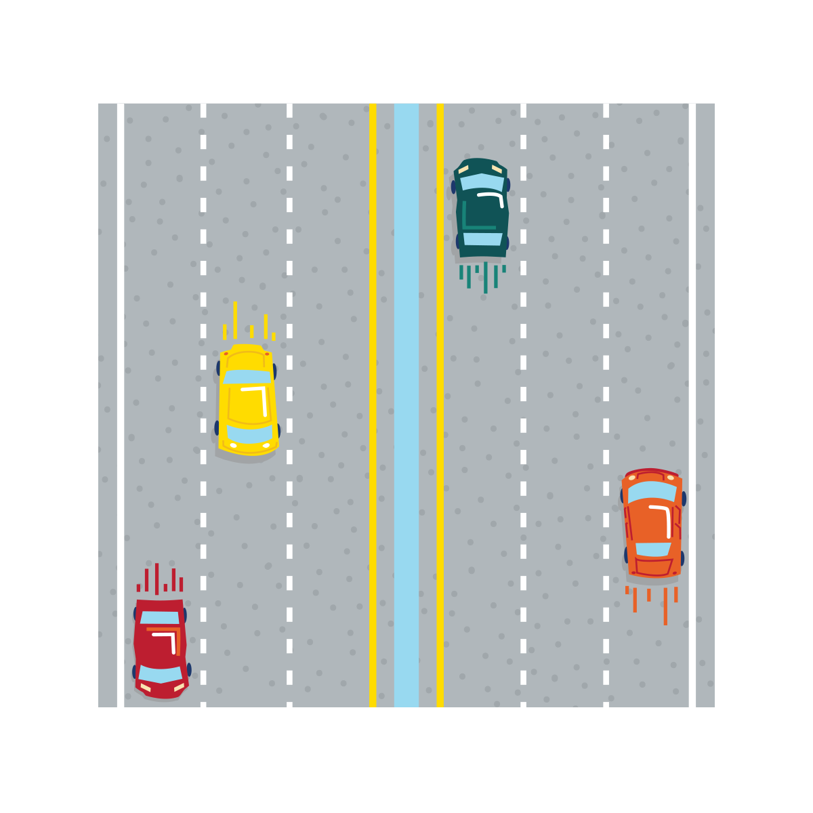
MetroPlan Orlando Region
2016-2025
17% Distracted driver
55% Posted speed >30
50% Roadway lanes >2

Slide 7
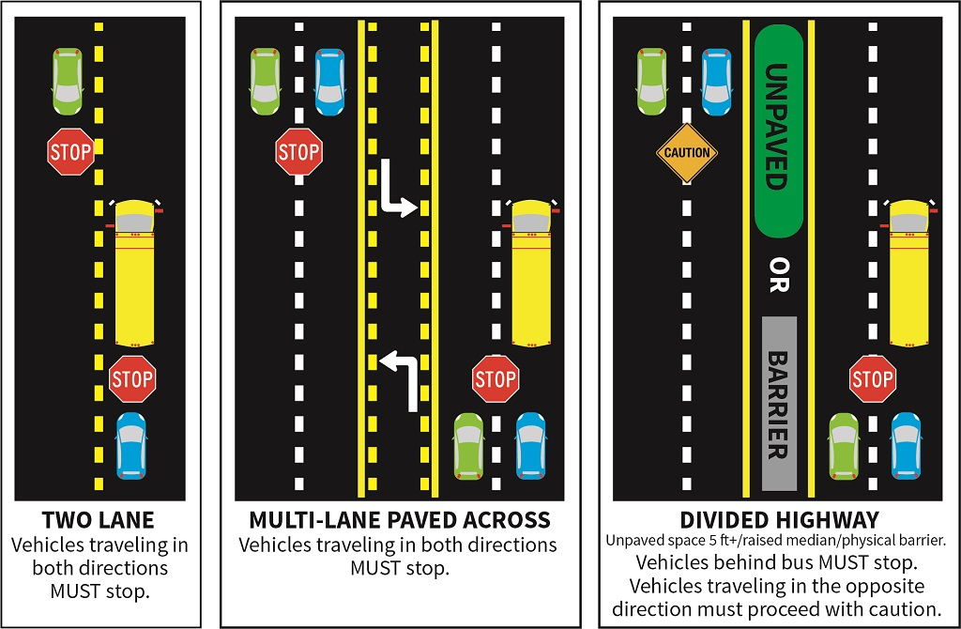
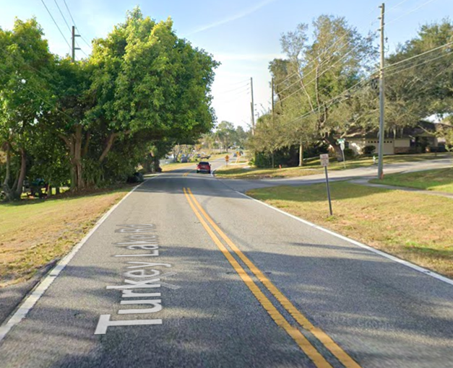

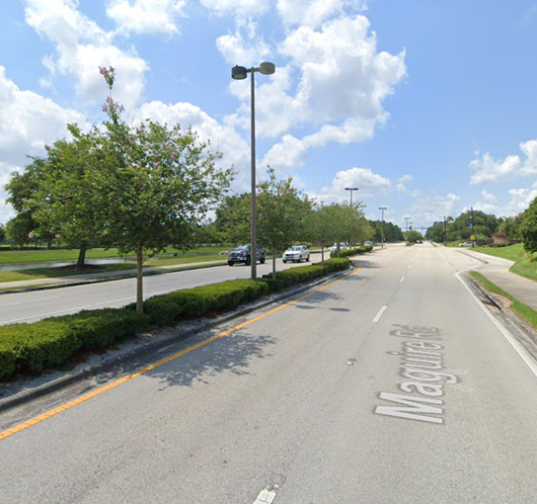
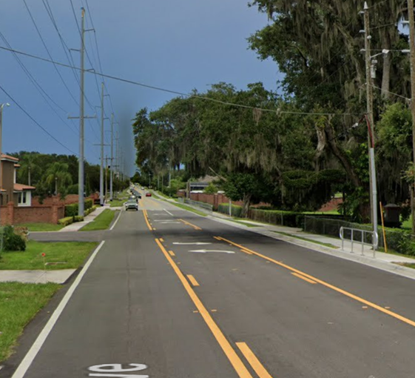
When are you required to stop?
Florida school buses carry precious cargo – our children!
Motorists are required to stop when approaching a school bus that is stopped with its red lights flashing and STOP arms extended

Slide 8

Protect our children.
Stop. Wait. Save a Life.
Every driver has the power to prevent a tragedy
  Stop when the bus stops
  Never pass a bus displaying its stop arm
  Slow down and stay alert in school zones
Together, we can achieve zero fatalities

Slide 9
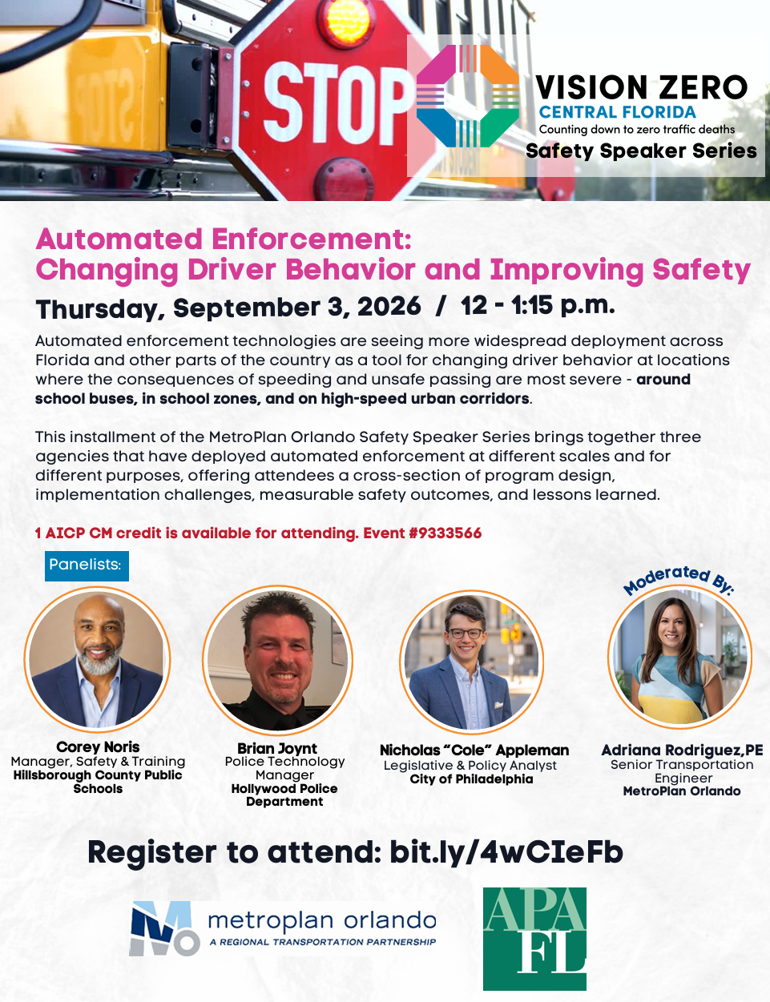

Resources
Insert Speaker Series Flyer & QR Code
Speaker Series - Automated Enforcement
School Bus Safety - Florida Department of Highway Safety and Motor Vehicles
  School Bus Safety Tips for Parents and Children
School Bus Safety | Bus Stops, Drivers | NHTSA
  Bus Stop Safety & Bus Safety
  Guide for Planning Safer School Bus Stops and Routes
  Reducing the Illegal Passing of School Buses Best Practices Guide

Slide 10
MetroPlanOrlando.gov I 407-481-5672
Adriana Rodriguez I Senior Transportation Engineer
Adriana.Rodriguez@MetroplanOrlando.gov

